Slide 1

Analysis of Recent Measles Outbreak
Rika Fukamachi
Chinedu Nwaka
Jam Paydavousi
Amanda Riley

Slide 2
BACKGROUND
Numerous media outlets ranging in credibility have reported concern over the rise of cases of Measles, previously thought contained by herd immunization with vaccinations of the United States population.
Our project seeks to
validate the reports by media
investigate the cause of the increased cases
provide information regarding the effectiveness of immunization and factors surrounding the spread and prevention of measles
Notes:
Numerous media outlets ranging in credibility have reported concern over the rise of Measles, previously thought contained by herd immunization with vaccinations of the United States population. This project seeks to first validate the reports by media, then investigate the cause of the increased cases, provide additional information regarding the effectiveness of immunization and factors surrounding the spread and prevention of measles. And finally, provide a recommendation based on the findings.

Slide 3
Historical Significance
1757 – Cause of measles first recognized as an infectious agent in the blood by Scottish physician
1912 – U.S. healthcare providers required to report all diagnosed cases of measles
1963 – First licensed vaccine in U.S.; later improved in 1971
2000 – Measles declared eliminated from the U.S.
2019 – Is the recent outbreak significant?
Has there been an increase in the measles cases within the US?
Notes:
The historical significance of the recent outbreaks in the united

Slide 4
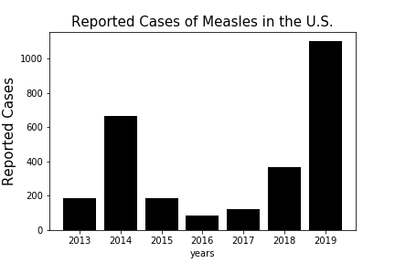

Has there been an increase in the measles cases within the US?
Is it consistent across the country?

Slide 5
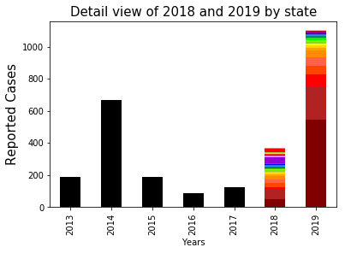
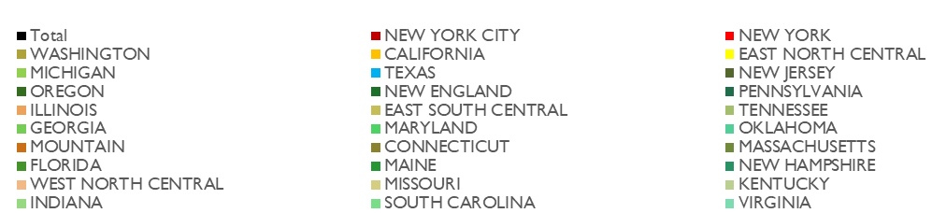
Is it consistent across states?
Are most of the cases reported from the same states as in 2018?

Slide 6
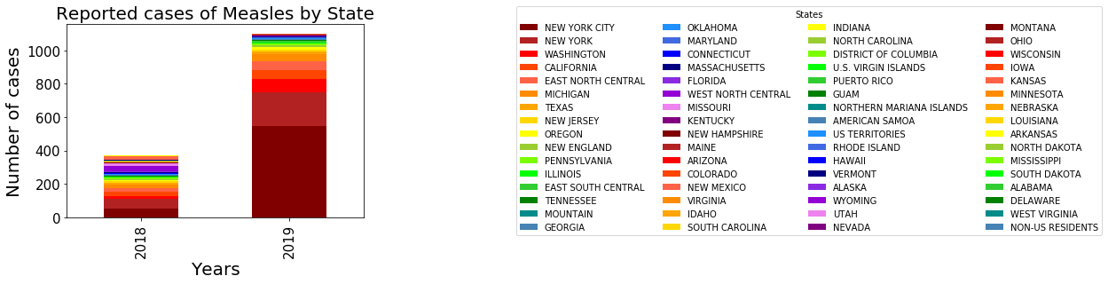
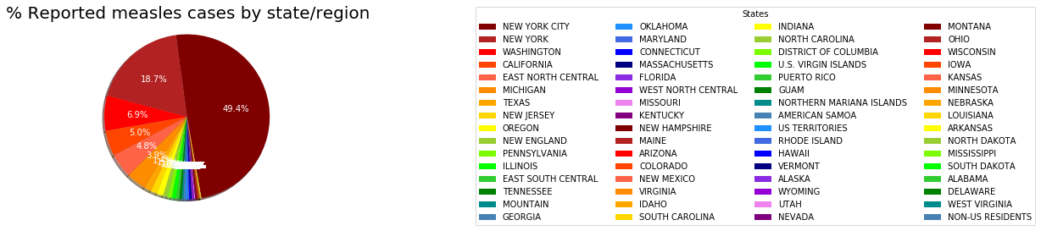
Are most of the cases reported from the same states as in 2018?
Which states have reported the most cases?

Slide 7
Which states have reported the most cases?
How many cases are Imported? How many cases are Domestic?
Notes:
Pandas

Slide 8
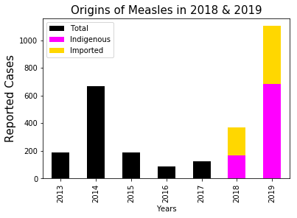
How many cases are Imported? How many cases are Domestic?
Notes:
Are these cases indigenous or imported?
2018 -2019: stacked bar chart that shows imported vs indigenous
Conclusion: it is both

Slide 9
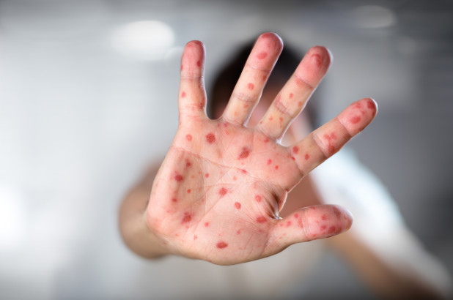
MEASLES OUTBREAKS PRIOR DECADES
Has the United States experienced similar outbreaks in the past?
Or is this recent outbreak a phenomenon?

Slide 10
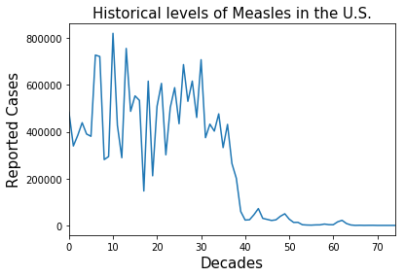
Measles Cases from 1928 – 2002 in the United States
Notes:
Yes: before vaccination was developed:
Display the chart for 1928 – 1950

Slide 11
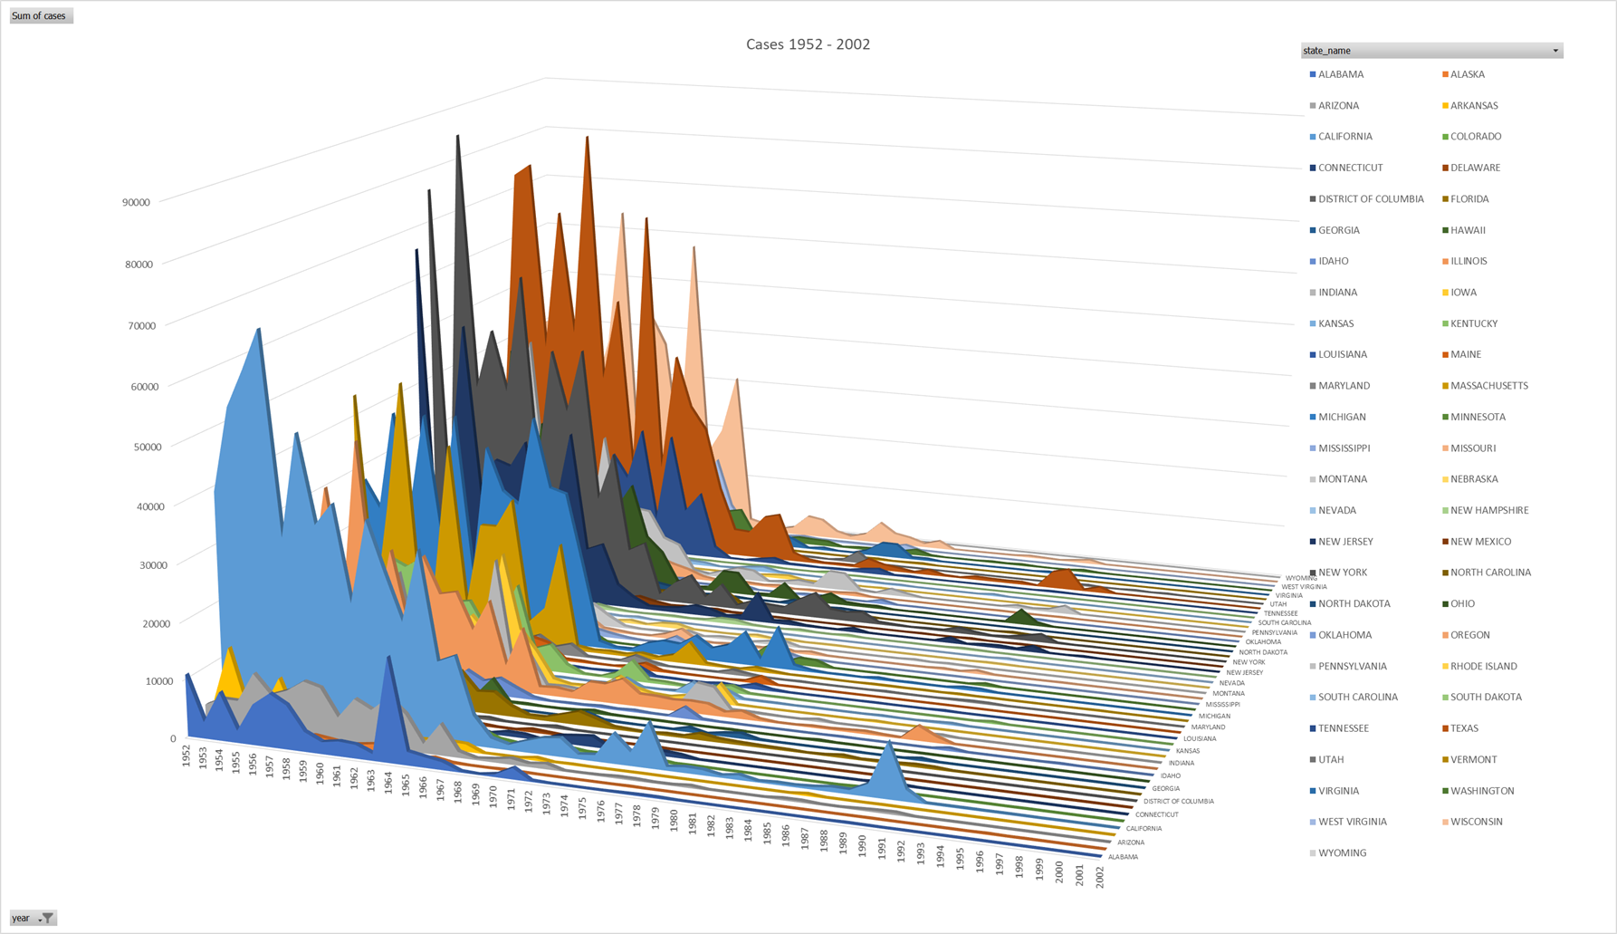
Measles Cases from 1952 – 2002 by State
Notes:
➢Note the dramatic decline due to the implementation of the vaccine
1970 - 2002
Again from 88 – 92:
This was when they realized that they needed a second dose of the MMR vaccines for effective resistance to the Measles
Top 5 states consistently included in subsequent outbreaks
<<charts>>

Slide 12
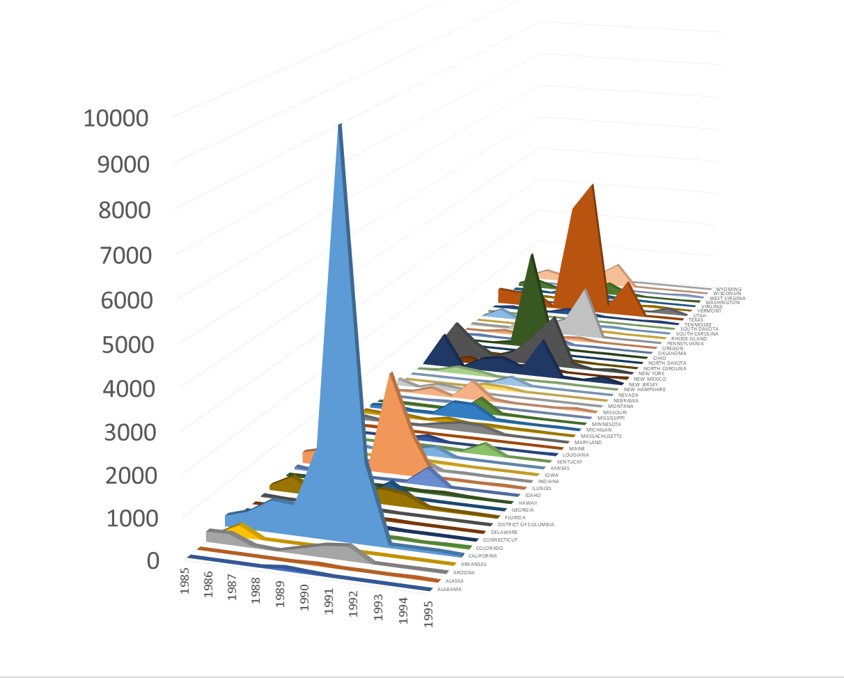
Measles Cases from 1985 – 1995 by State
Notes:
➢Note the dramatic decline due to the implementation of the vaccine
1970 - 2002
Again from 88 – 92:
This was when they realized that they needed a second dose of the MMR vaccines for effective resistance to the Measles
Top 5 states consistently included in subsequent outbreaks
<<charts>>

Slide 13
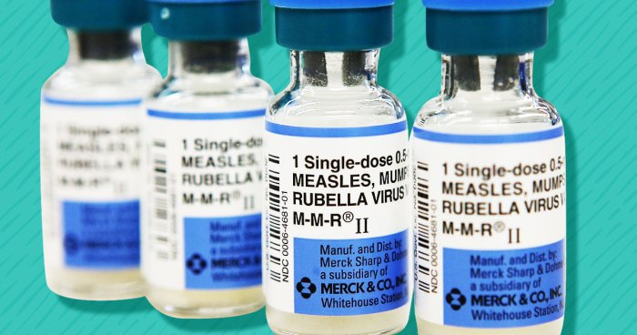
Recent Vaccination Patterns in the U.S

Slide 14
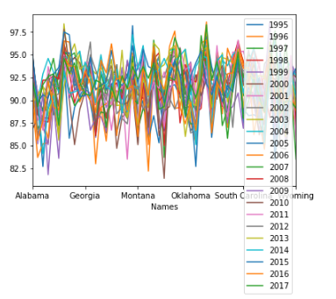
Have Vaccination Levels Changed in the U.S.?
Notes:
As you can see, this is a terrible visualization as we can’t really see any major trends

Slide 15
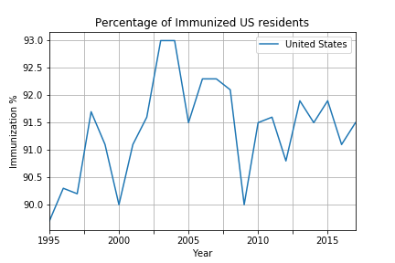
Vaccination Levels for Measles in the U.S.
Notes:
generally stable at the 90 percentile

Slide 16
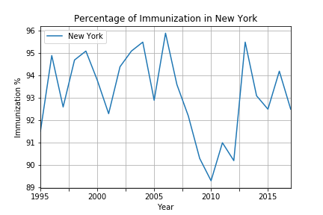
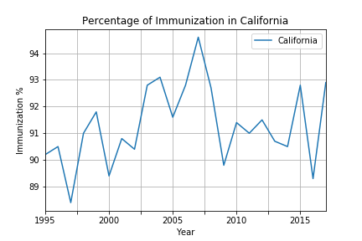
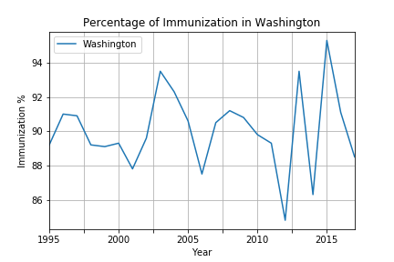
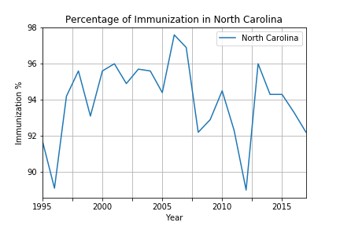
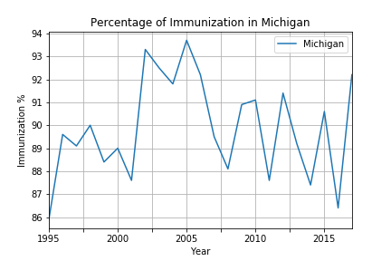
Vaccination Levels in Top States with Measles Outbreaks
Notes:
Significant dips in immunizations at different years but does not correlate with the measles outbreak (display function)
How is the immunization rates in the top 5 states with measles outbreaks

Slide 17
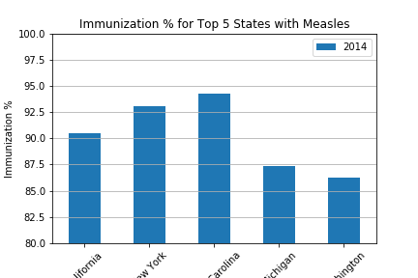
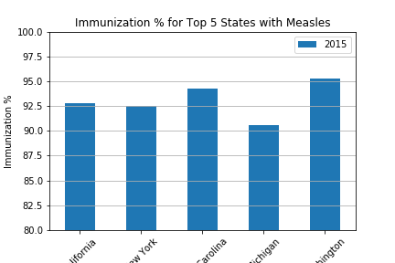
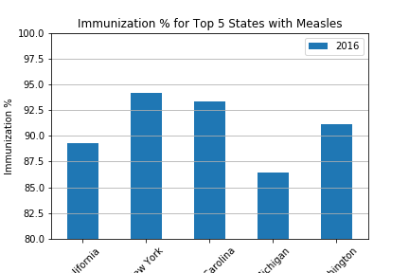
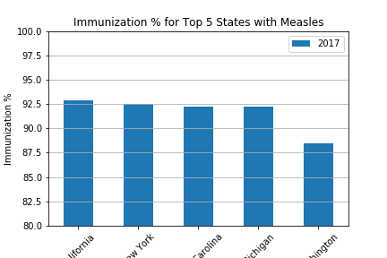
Percentage of Population Vaccinated for Top Outbreak States 2014 – 2017
Notes:
How is the immunization rates in the top 5 states with measles outbreaks
Conclusion: lack of immunization is not the main cause of the outbreaks.

Slide 18
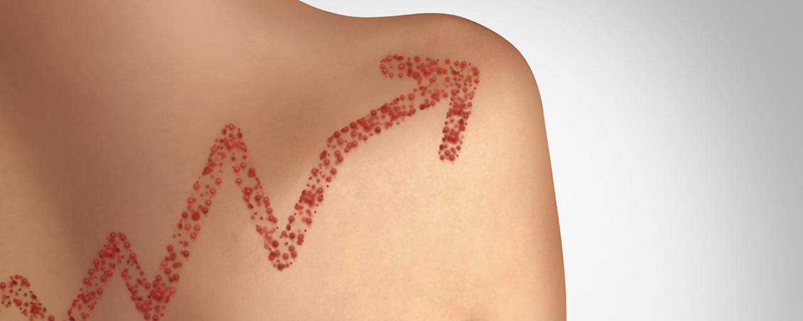
International Measles Cases by Year

Slide 19
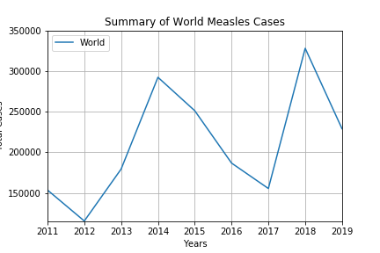
How many cases of measles have occurred annually?
Which countries are highest in measles cases?

Slide 20
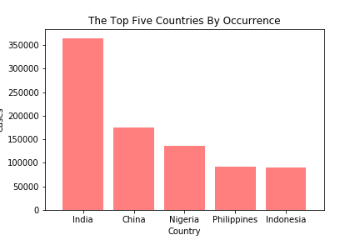
Which countries have the most cases of measles?

Slide 21
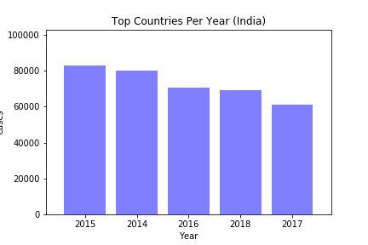
Ranking of India’s Annual Cases

Slide 22


Code Snippets

Slide 23
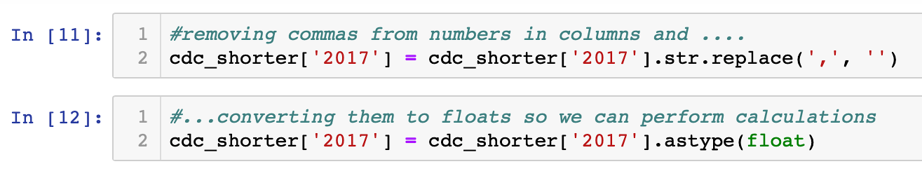
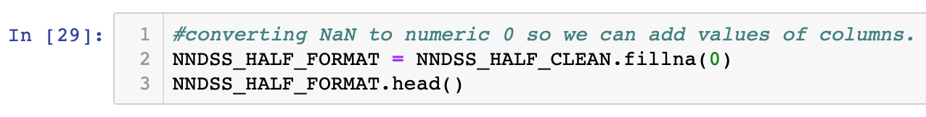
Data Cleaning
1,049 >>> 1049
NaN >>> 0

Slide 24
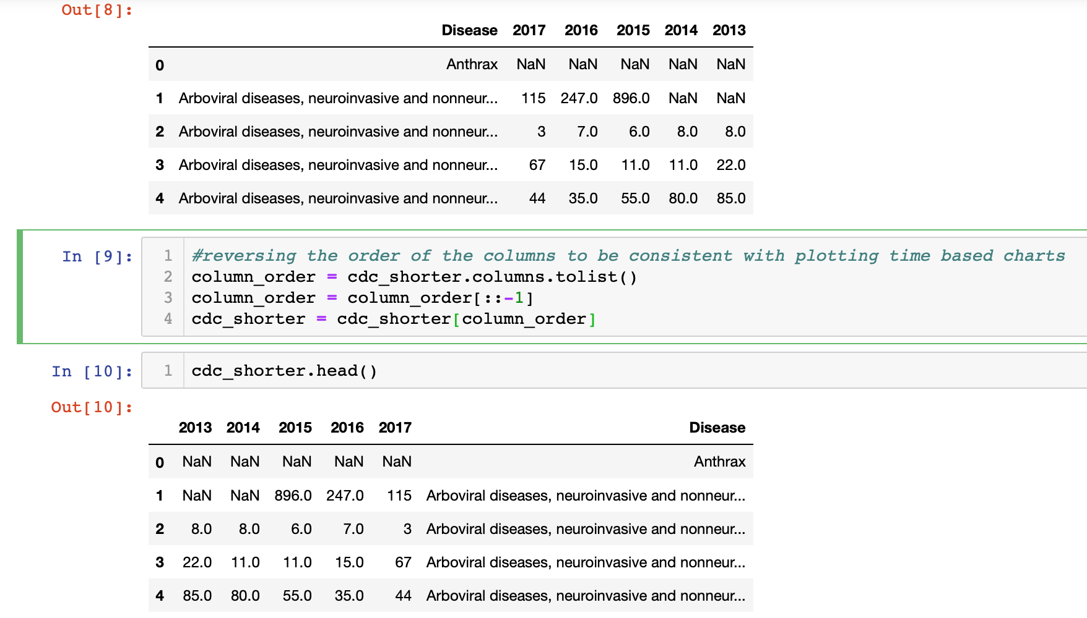
Data Frame Formatting

Slide 25
Code Snippets

Slide 26
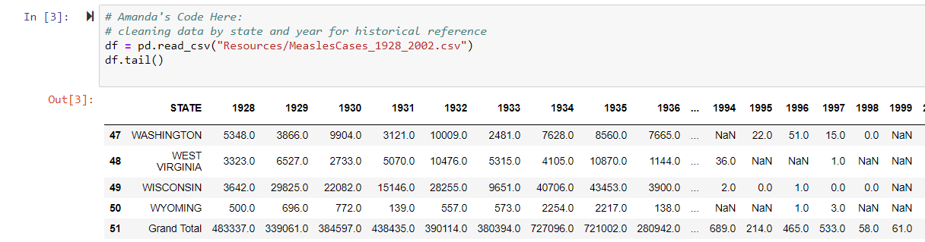
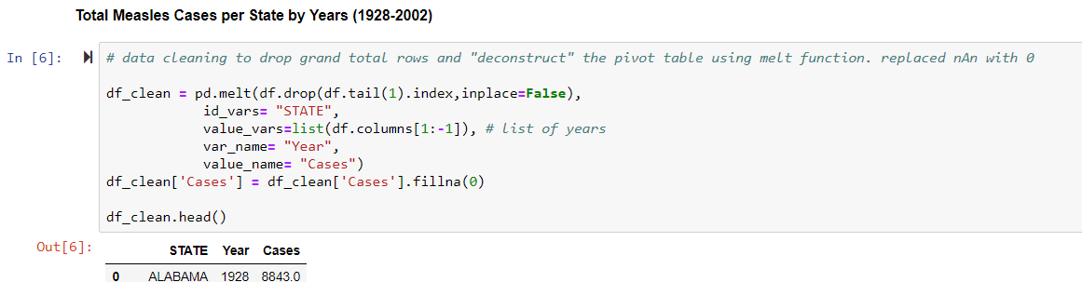

Slide 27
Code Snippets

Slide 28
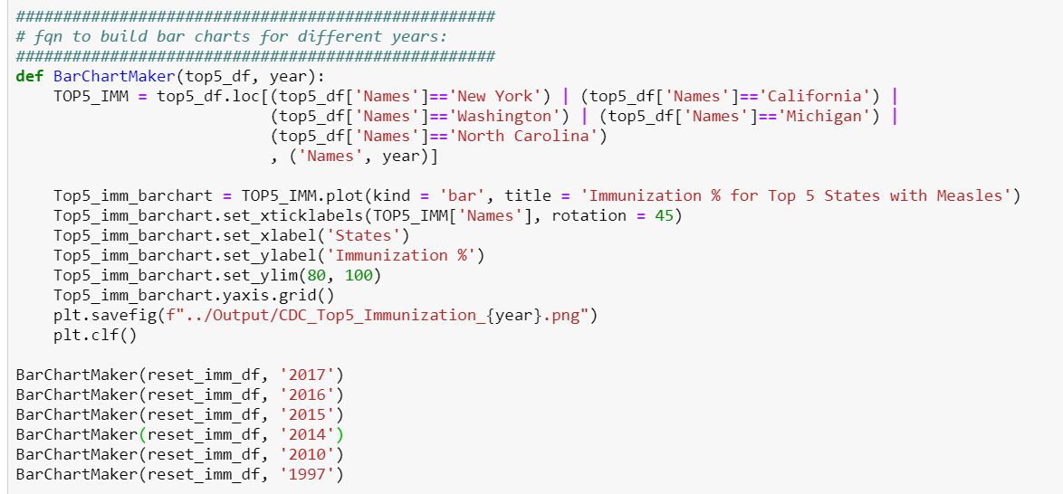
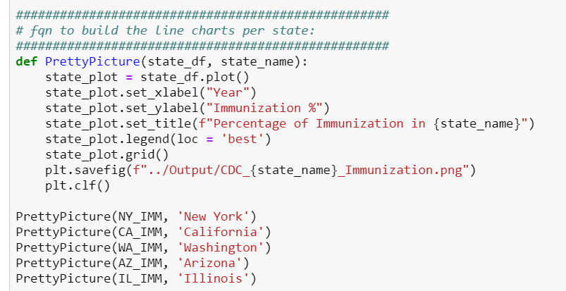

Slide 29
Code Snippets

Slide 30
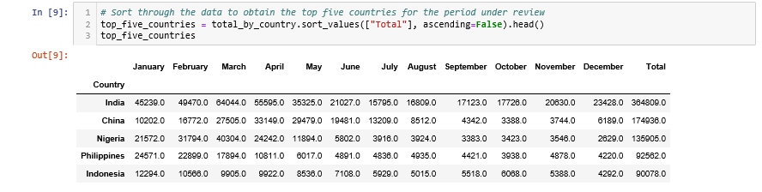
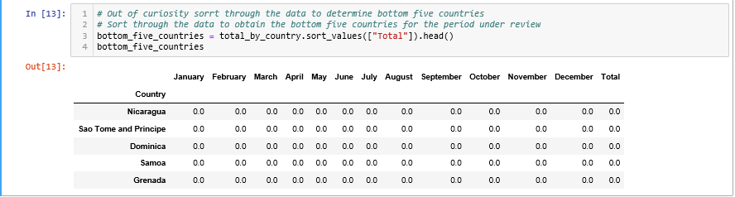
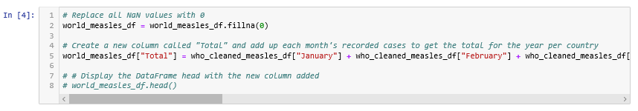

Slide 31
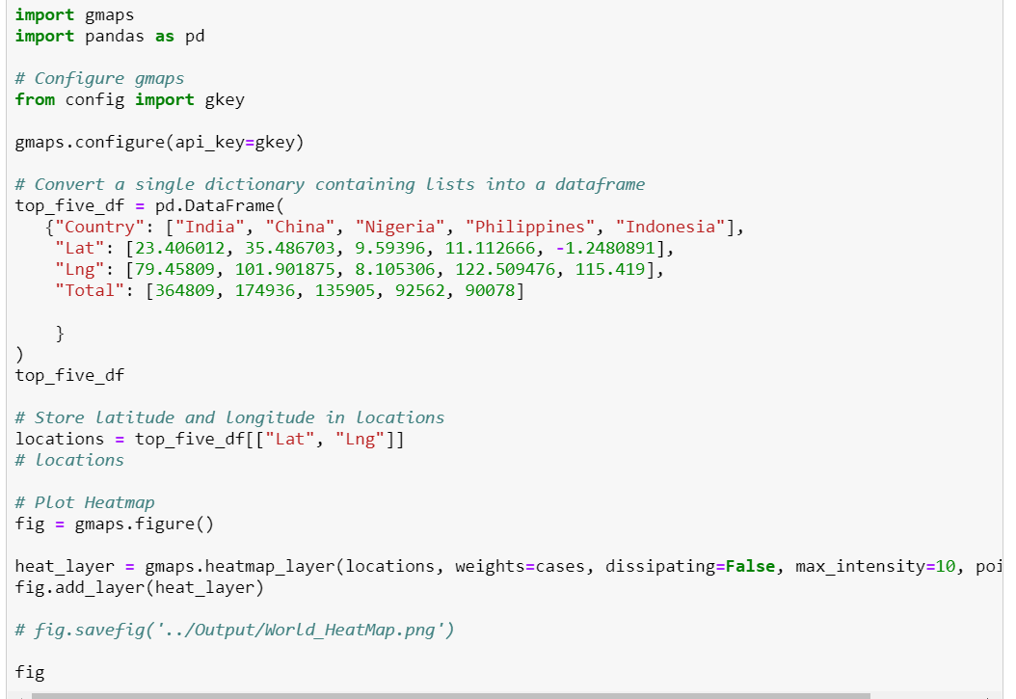
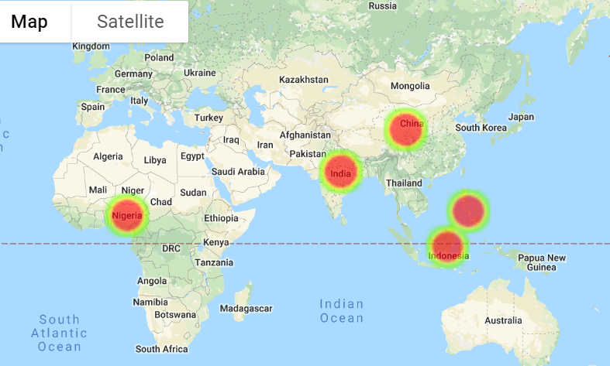

Slide 32
Travel with Caution

Slide 33
Closing Remarks
Increase in recent measles cases cannot clearly be attributed to one factor
“Anti-Vax”
Import countries
Avoid travel to these countries without proper immunization

